Slide 1
Comparing Distributions
t-test
F-test
Kolmogorov-Smirnov test

Slide 2
Comparing Distributions
We have two samples
  Different variables, from the same population
  The same variable, from different populations
How different are the two distributions these samples come from?
Probably the most common question in data analysis
  Does a certain treatment reduce the likelihood of acquiring a disease of interest?
  Are women who run the Boston Marathon tend to be younger than men who run the Boston Marathon?
  What are the genes that are differentially expressed in metastatic colon cancer as compared to the primary tumor?
What to compare?
  Means => (Student’s) t-test
  Variances (or more than two categories) => F-test
  Distributions => Kolmogorv-Smirnov test

Slide 3
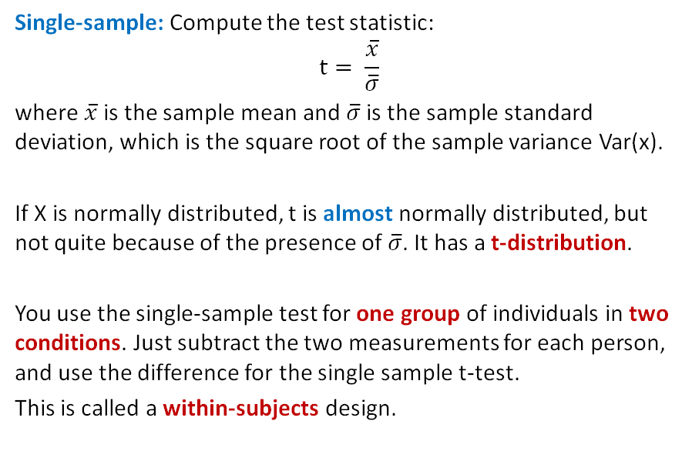

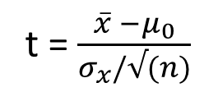


The t-Statistic
For a single variable, the hypothesis we are testing is whether the mean is significantly different than μ0
t = $\frac{\overline{x} −μ_{0}}{σ_{x}/√(n)}$
Example: Do people run faster with shorts or pants?
$${ \text{x}\text{̄}}_{pants−shorts}$$
To compare the means of two variables, test whether the difference between their means is different than μ0
$$μ_{pants−shorts}$$

Slide 4
Examples
Quality Control: A factory produces batteries that are supposed to last 10 hours on average. We take a sample of 30 batteries and find their average lifespan. A single sample t-test can determine if the true mean lifespan differs significantly from 10 hours.
Education: A school claims its students score 75 on average on a standardized test. We collect test scores from 20 students and use a single sample t-test to check if the true average differs from 75.
Medical Studies: A pharmaceutical company claims that a new drug reduces blood pressure by 8 mmHg on average. We take a sample of 15 patients and measure their actual reduction to test this claim.

Slide 5
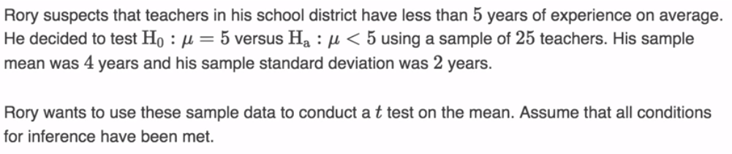
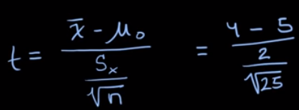

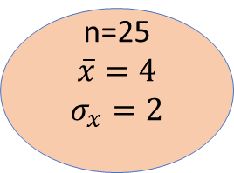
Example
n=25
$$\overline{x}=4$$
$$σ_{x}=2$$
population

Slide 6
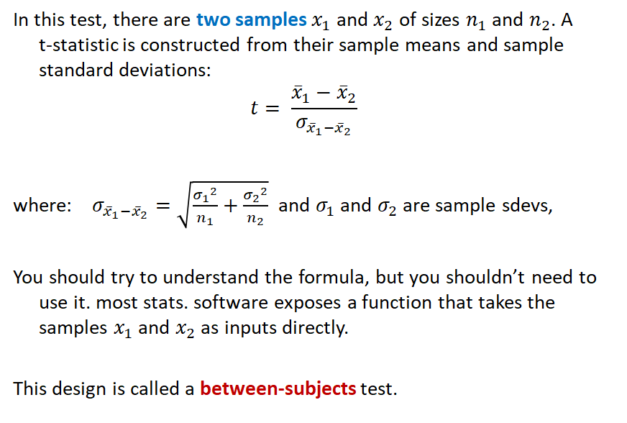


Two Sample t-test
Example: Is there a different between salaries of men and women?
$$μ_{men}$$
$$μ_{women}$$

Slide 7
Examples
Education: Do students who study with a tutor score higher on exams than those who study alone?
Healthcare: Is the average reduction in blood pressure different between two different medications?
Business: Do customers from two different stores spend the same amount on average?
Sports: Do male and female athletes have different average heart rates after exercise?

Slide 8
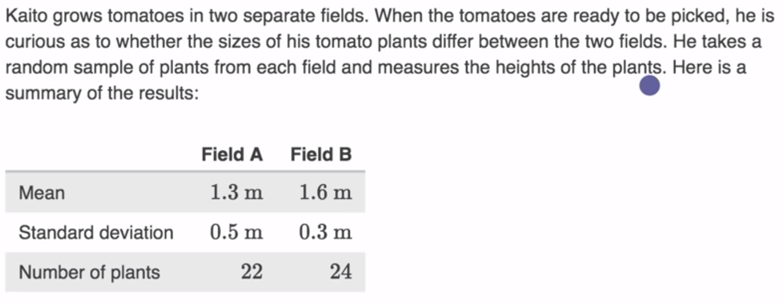


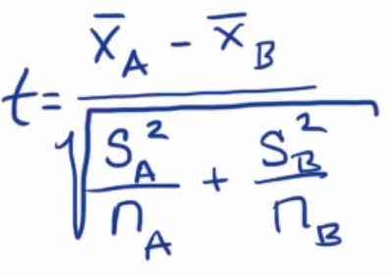
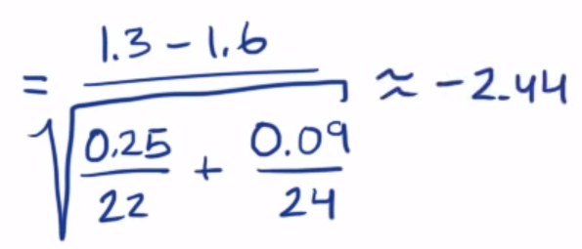
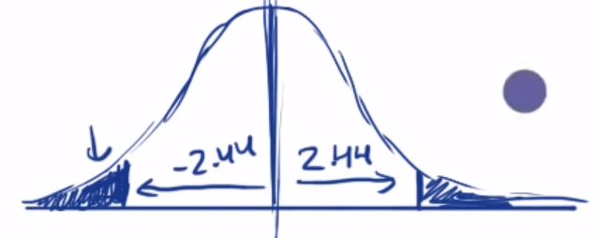

Example
We reject the null hypothesis if the p-value < 0.05

Slide 9
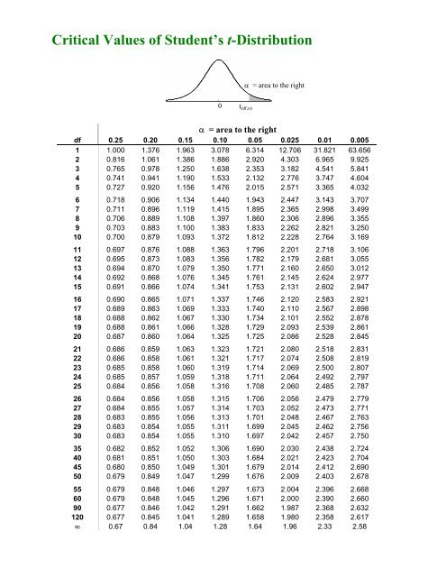
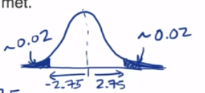
Finding p-value associated to t test statistics using t table
Suppose t = 2.75 ;
Number of observation = 6
n-1
P-value = 0.04

Slide 10
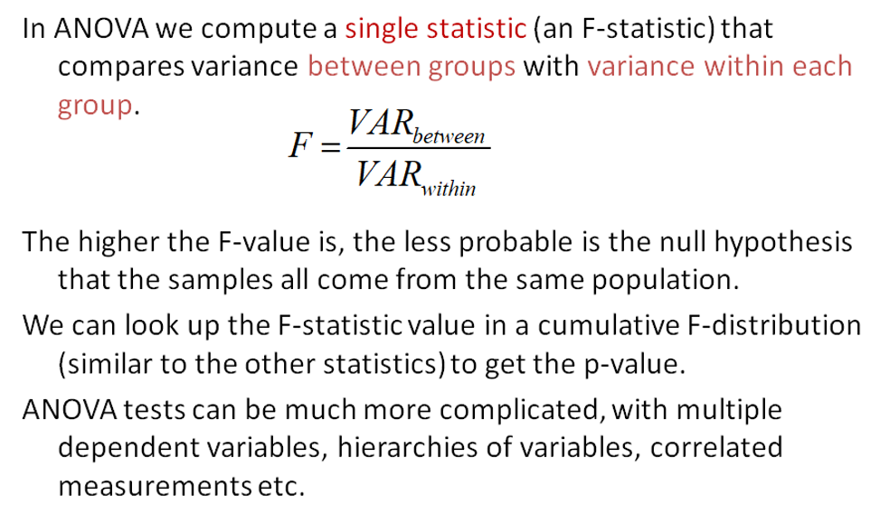
Comparing Variances
ANOVA (Analysis of Variance) allows testing of multiple differences in a single test.

Slide 11
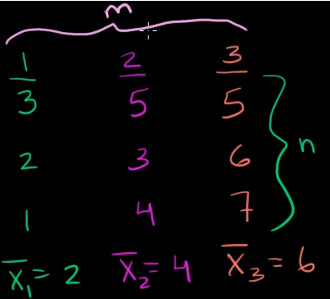

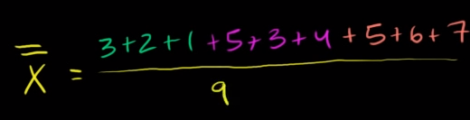
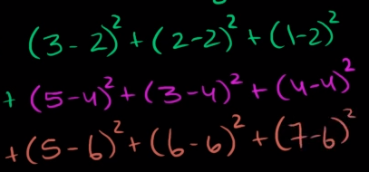
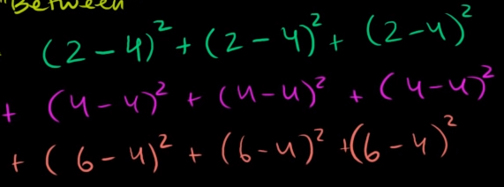
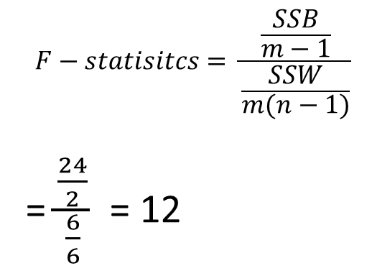
Example
Number of hours they watch cartoons$;significance level α<0.10$
College Student (1) | Highschool Student (2) | Elementary Student (3)
3 | 5 | 5
2 | 3 | 6
1 | 4 | 7
= 4
Sum of Square (within groups): SSW
Sum of Square (between groups): SSB
$$F−statisitcs= \frac{\frac{SSB}{m−1}}{\frac{SSW}{m(n−1)}}$$
= $\frac{\frac{24}{2}}{\frac{6}{6}}$ = 12
=6 degree of freedom=2+2+2=6
m*n - 1
=24 degree of freedom=3-1 = 2
m-1

Slide 12
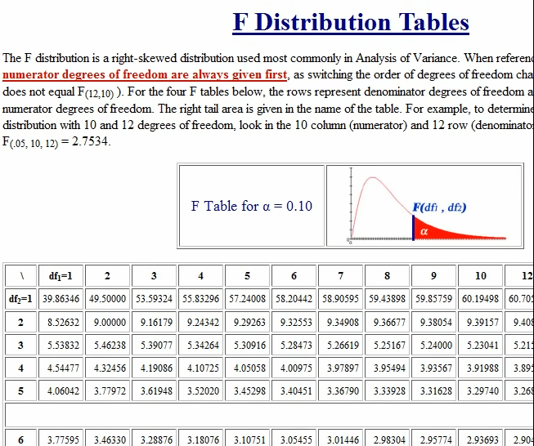

Example
What is the critical value for $α=0.10$
Critical F-value = 3.46
Our value = 12 >>> 3.46
Reject null hypothesis
There is a difference
Between students in different
Level of education
So level of education is important
Numerator DF
Denominator DF

Slide 13
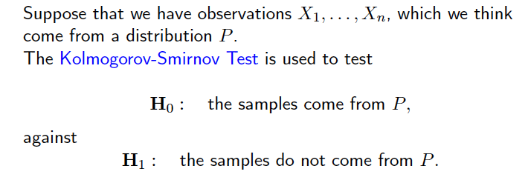
Kolmogorov-Smirnov Test
Compare cumulative distribution functions
  Can be used to assess how “different” two empirical distributions are
  Or to assess whether an hypothesized distribution approximates an empirical distribution well enough

Slide 14
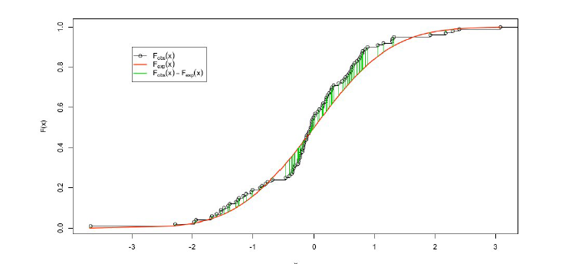
KS-Statistic Visualized

Slide 15
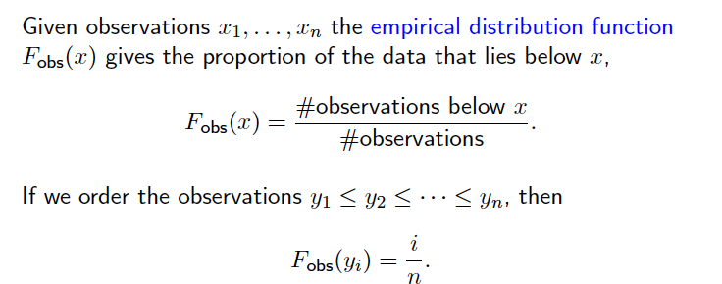
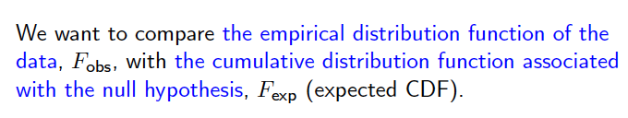
Observed vs. Expected Cumulative Distribution

Slide 16

Kolmogorov-Smirnov (KS) Statistic
It can be proven that, if the sample is taken from the hypothesized distribution, then this largest difference between the cumulative distribution functions goes to 0 as sample size goes to infinity

Slide 17
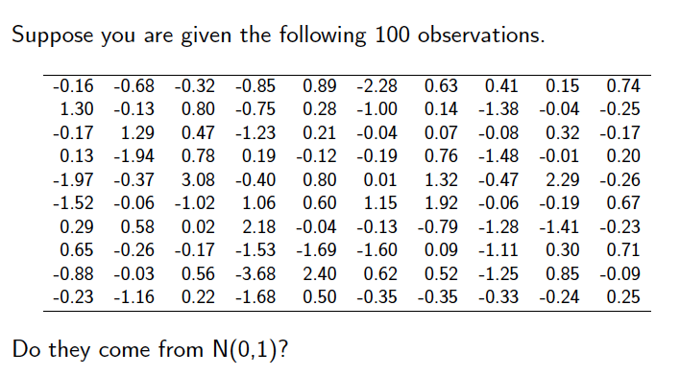
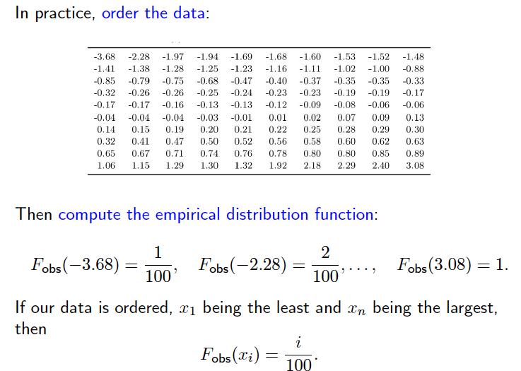
Example: Computing The Observed Cumulative Distribution

Slide 18
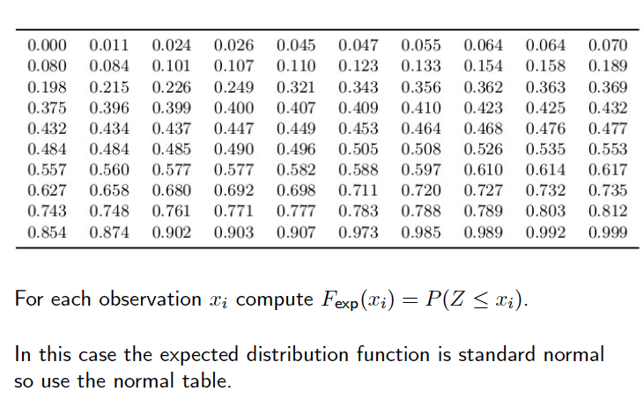
Computing The Expected Cumulative Distribution

Slide 19
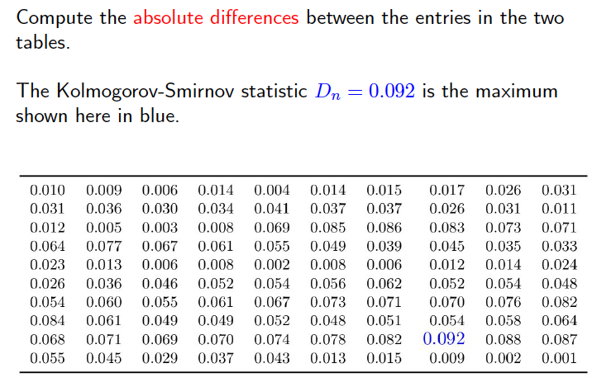
Computing The Difference

Slide 20
KS-Statistic Visualized

Slide 21
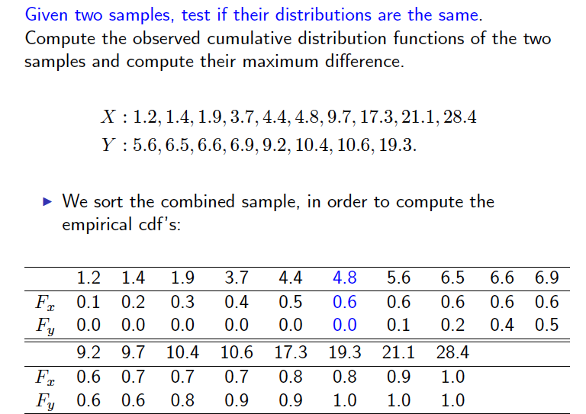
Example: KS-Test for Comparing to Samples

Slide 22
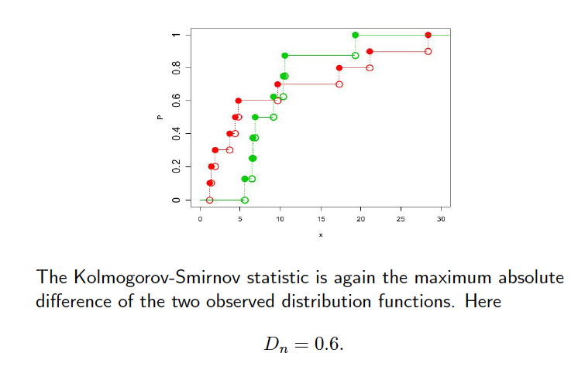
Example: Visualization of KS-Statistic for Comparing to Samples

Slide 23
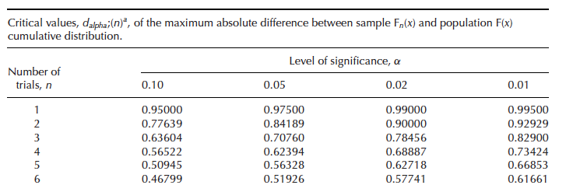
The Distribution of KS (or D)-Statistic
The KS-statistic itself is usually not informative on the difference between the two distributions
  Need to compute p-value for hypothesis testing
It is difficult to characterize the distribution of the KS-statistic but many algorithms exist

Slide 24
Kahoot time

